Slide 1

Support Vector Machines
Michigan Hackers Machine Learning Team

Slide 2

Today’s Agenda
Announcements
Icebreaker
Review Decision Trees and Random Forests
Support Vector Machines
Solution to Iris Classification Project
Work and Ask Questions

Slide 3
Announcements
The LSA Course Guide for Winter 2021 is out
Browse through the courses for next semester and see what you like
MIDAS Seminar Series: Paul Bennett – Microsoft
Date&Time: November 16th, 4-5 pm
Meet Paul Bennett who is a Senior Principal Research Manager at Microsoft
Friday Night AI: Teaching Robots through Natural Interactions
Date&Time: November 22nd, 7:00 – 8:30 pm
Learn about how reinforcement learning is used to create intelligent systems in the field of robotics.
This is our second to last meeting for the semester!
Please give us feedback on what you want to learn and accomplish for next semester.

Slide 4
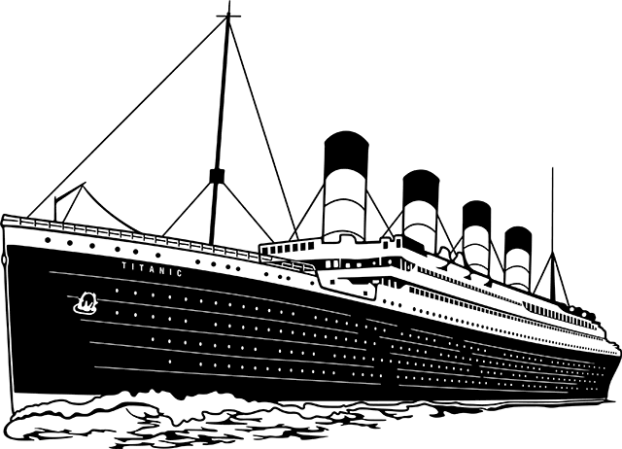
Ice Breaker
Have you started the Titanic Project?

Slide 5
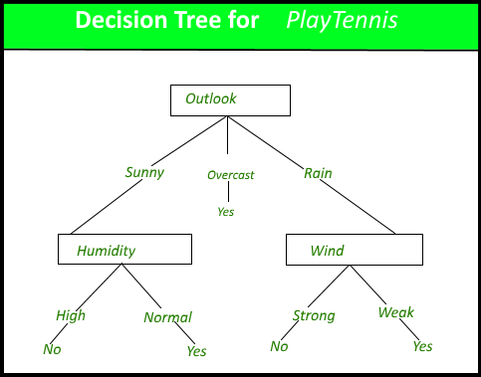
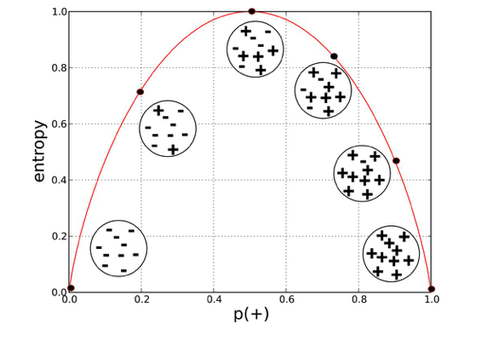

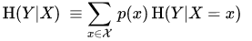
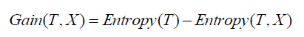
One Slide Review of Decision Trees
Decision Trees are ML algorithms that progressively divide data sets into smaller data groups based on a descriptive feature, until they reach sets that are small enough to be described by some label.
Learning Decision Trees can be time costly, so a heuristic for it calculating greedily choosing the feature that gives the largest information gain to split on until the lead nodes have minimal entropy, that is, splitting more doesn’t result in more information gain

Slide 6
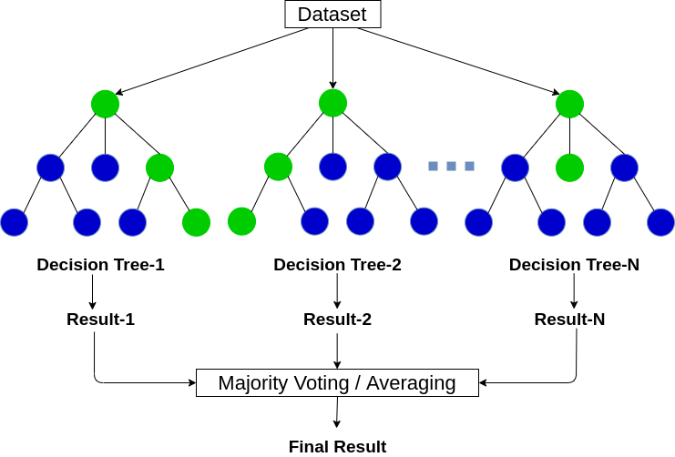
One Slide Review of Random Forests

Slide 7
Support Vector Machines

Slide 8
SVMs: Preliminaires and Definition
Introduction:
We’ve learned about regularized logistic regression for binary classification so far. Support vector machine is another algorithm that is widely used in machine learning. Support vector machine is highly preferred by many as it produces significant accuracy with less computation power. Support Vector Machine, abbreviated as SVM can be used for both regression and classification tasks. But, it is widely used in classification objectives.
Definition:
The objective of the support vector machine algorithm is to find a hyperplane in an N-dimensional space (N — the number of features) that distinctly classifies the data points.

Slide 9
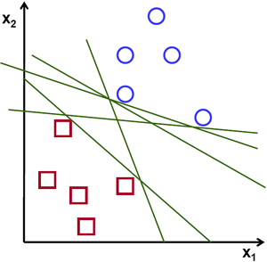
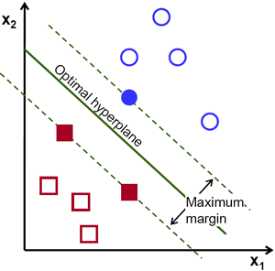
The Objective of SVMs
Simple Classification Algorithms
Support Vector Machine Algorithm
To separate the two classes of data points, there are many possible hyperplanes that could be chosen. Our objective is to find a plane that has the maximum margin, i.e the maximum distance between data points of both classes. Maximizing the margin distance provides some reinforcement so that future data points can be classified with more confidence.

Slide 10
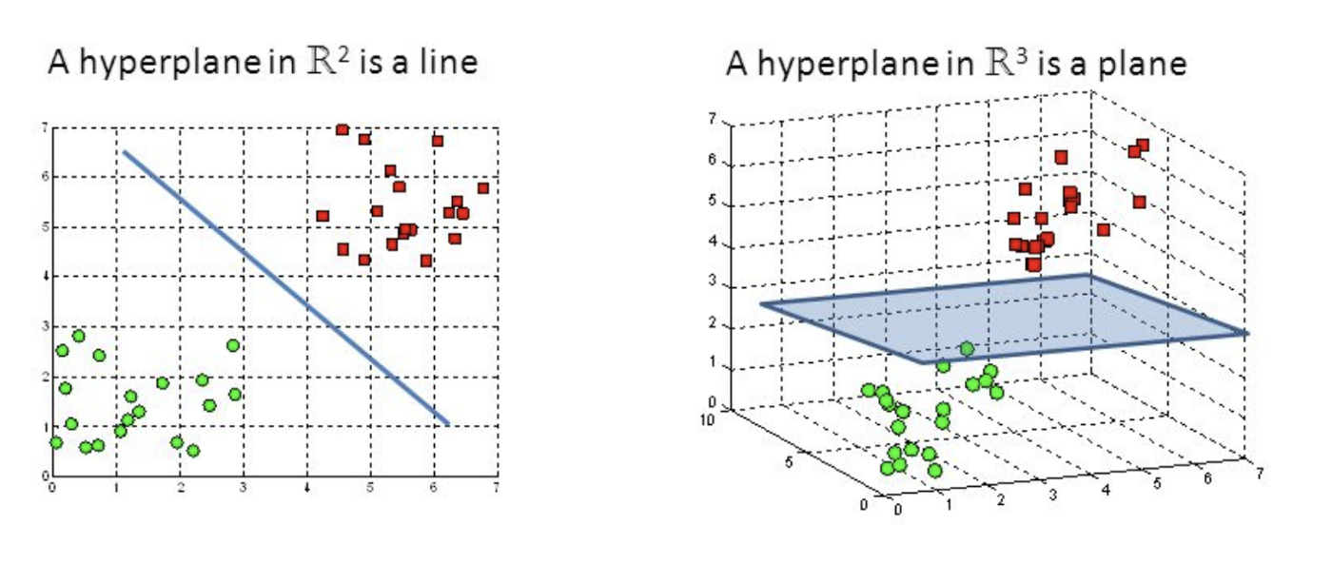
Hyperplanes
Hyperplanes are decision boundaries that help classify the data points. Data points falling on either side of the hyperplane can be attributed to different classes. Also, the dimension of the hyperplane depends upon the number of features. If the number of input features is 2, then the hyperplane is just a line.

Slide 11
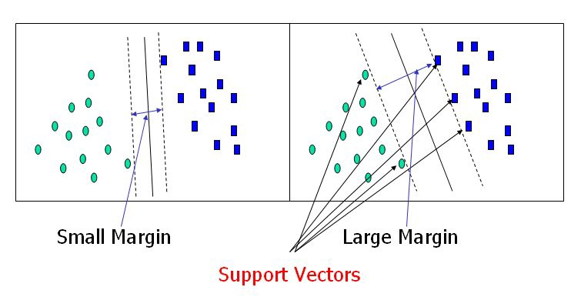
Support Vectors
Support vectors are data points that are closer to the hyperplane and influence the position and orientation of the hyperplane. Using these support vectors, we maximize the margin of the classifier. Deleting the support vectors will change the position of the hyperplane. These are the points that help us build our SVM.

Slide 12
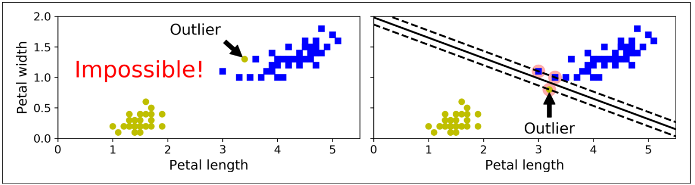
Hard-Margin SVMs
Hard margin classification strictly imposes that all instances must be lie on one side of the decision boundary. There are two main issues with hard margin classification. First, it only works if the data is linearly separable. Second, it is sensitive to outliers.

Slide 13
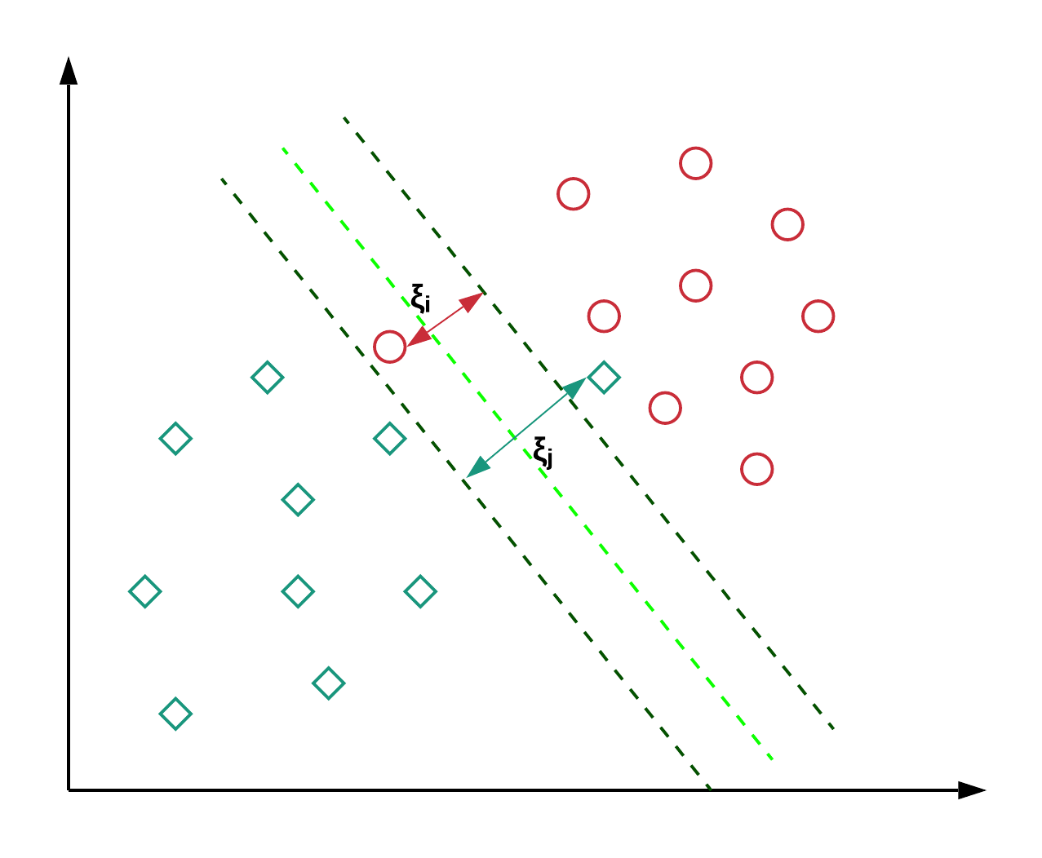
Soft-Margin SVMs
To avoid these issues, we use a more flexible model. The objective is to find a good balance between keeping the margin as large as possible and limiting the margin violations (i.e., instances that end up in the middle of the street or even on the wrong side). This is called soft margin classification.
A common way to implement soft-margin SVM is introducing a slack variable that shifts incorrect data points to the right side of the decision boundary.

Slide 14
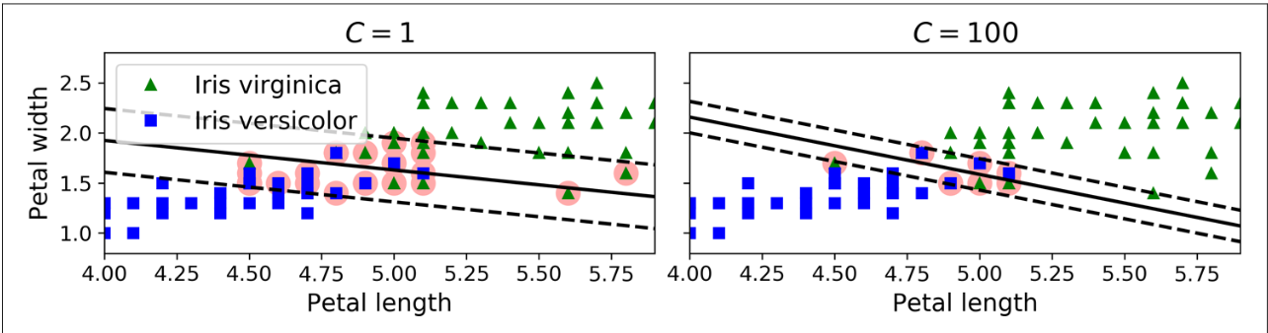
Linear Support Vector Classification
The following Scikit-Learn code loads the iris dataset, scales the features, and then trains a linear SVM model (using the LinearSVC class with C=1 and the hinge loss function) to detect Iris virginica flowers.

Slide 15
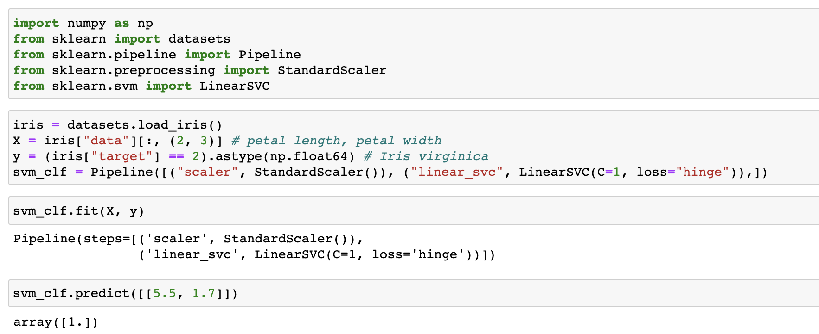
Implementation of Linear SVM

Slide 16
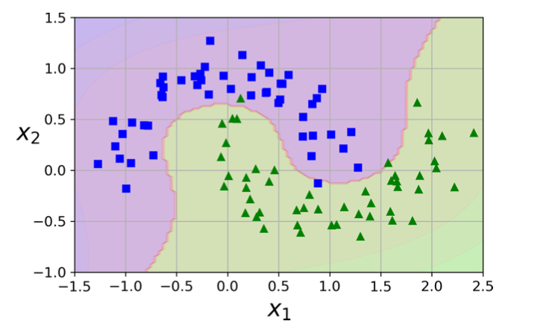
Nonlinear Support Vector Classification
Adding polynomial features is simple to implement and can work great with all sorts of Machine Learning algorithms (not just SVMs). That said, at a low polynomial degree, this method cannot deal with very complex datasets, and with a high polynomial degree it creates a huge number of features, making the model too slow.

Slide 17
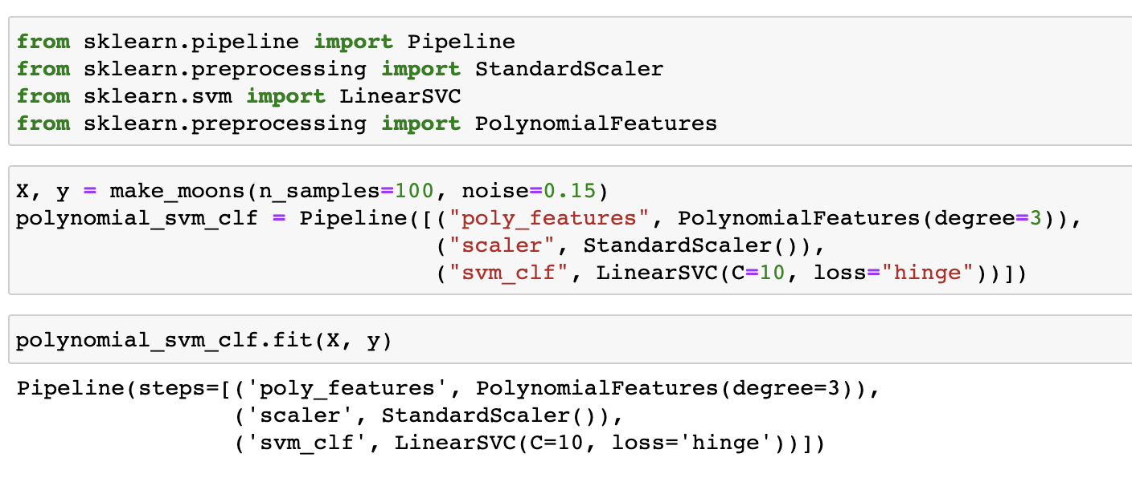
Implementation of Nonlinear SVM

Slide 18
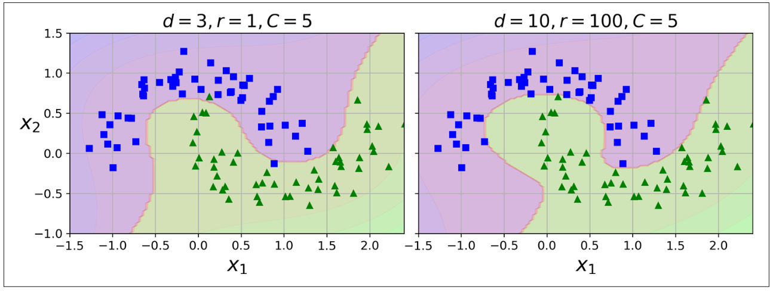
Nonlinear SVM using Kernel Trick
Fortunately, when using SVMs you can apply a mathematical technique called the kernel trick which makes it possible to get the same result as if you had added many polynomial features, even with very high-degree polynomials, without actually having to add them. So there is no combinatorial explosion of the number of features because you don’t actually add any features. This trick is implemented by the SVC class.

Slide 19
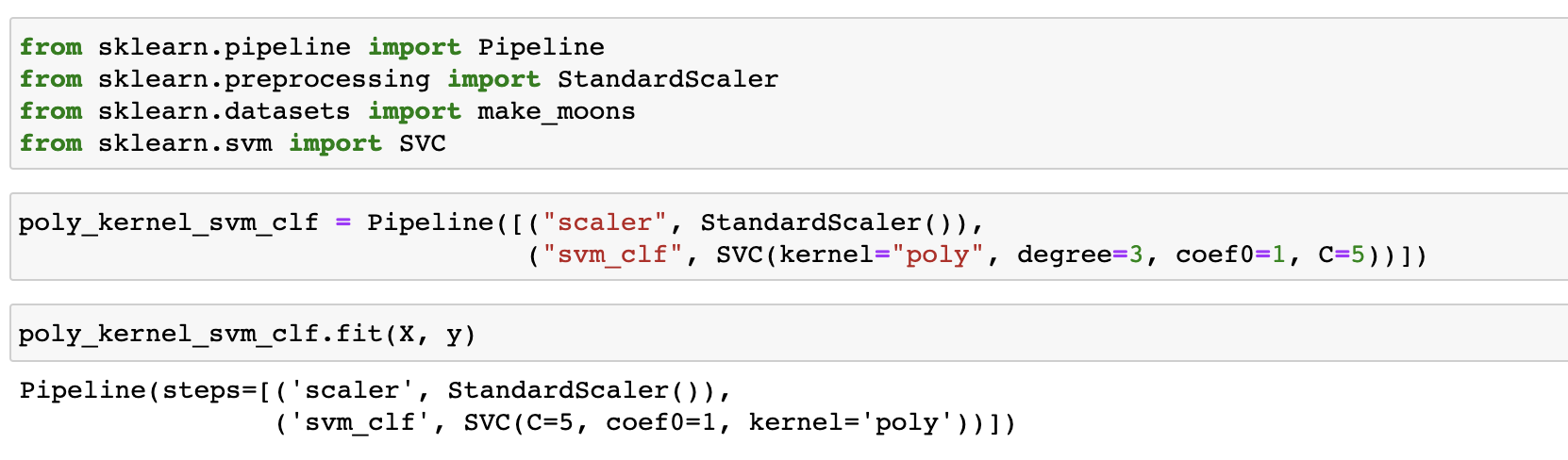
Implementation of SVC using Kernel Trick

Slide 20
Iris Classification Project

Slide 21

Solution to Iris Classification Project

Slide 22
Titanic Project

Slide 23
Kaggle’s Titanic Project

Slide 24
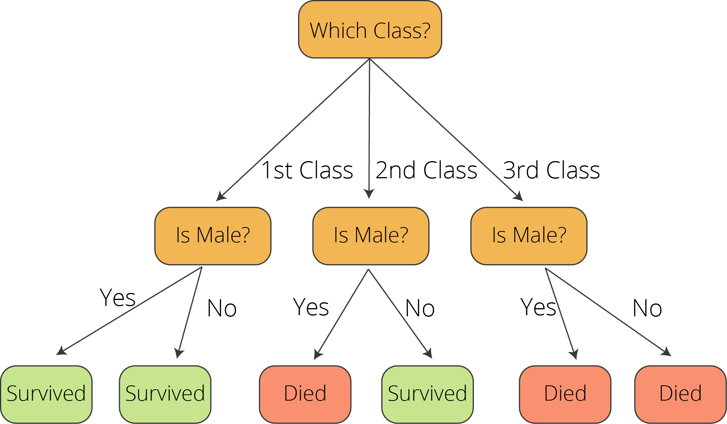
Kaggle’s Titanic Project Tutorial

Slide 25
Work for Rest of Semester
Strongly Recommended (highest to lowest priority)
Python Beginners: Complete through Course 3 of the Python 3 Programming specialization.
Kaggle Titanic Tutorial
Iris Classification
Coursera project: Pandas Python Library for Beginners in Data Science
Bonus
Intermediate: Read Chapter 16: Logistic Regression with SVMs in Data Science from Scratch
Experienced: Read Chapter 5: SVMs in Hands-On ML.
If you are brave enough, attempt the Titanic Project without following the tutorial!

Slide 26
Thank You!
Michigan Hackers Machine Learning Team
Contact Info:
Rajas Gupta | rajasg@umich.edu
Vijay Shamra | vsharm@umich.edu
Provide Feedback

